Slide 1






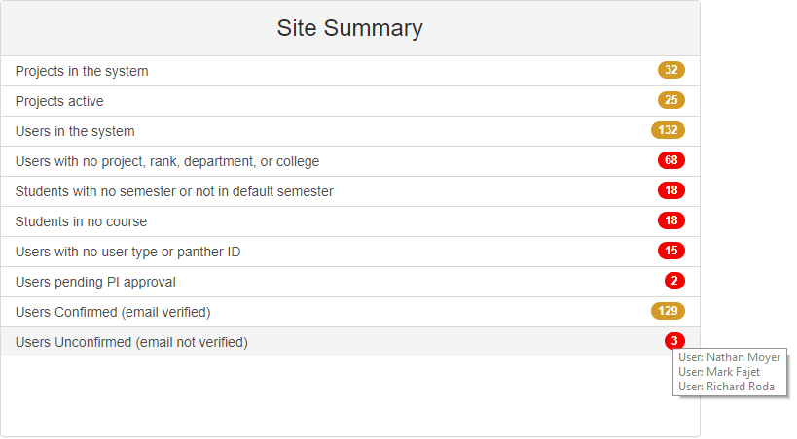
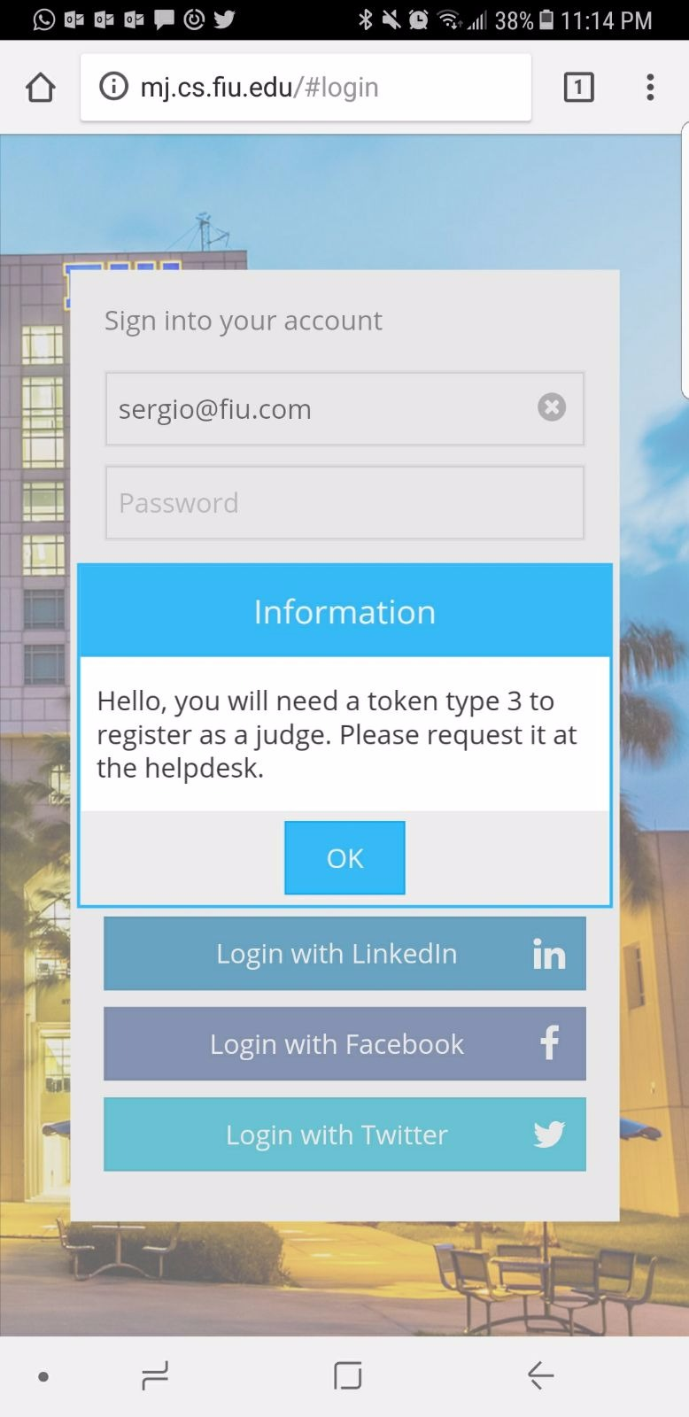
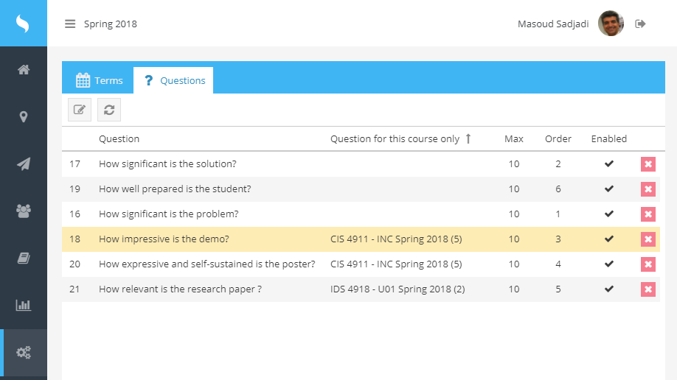
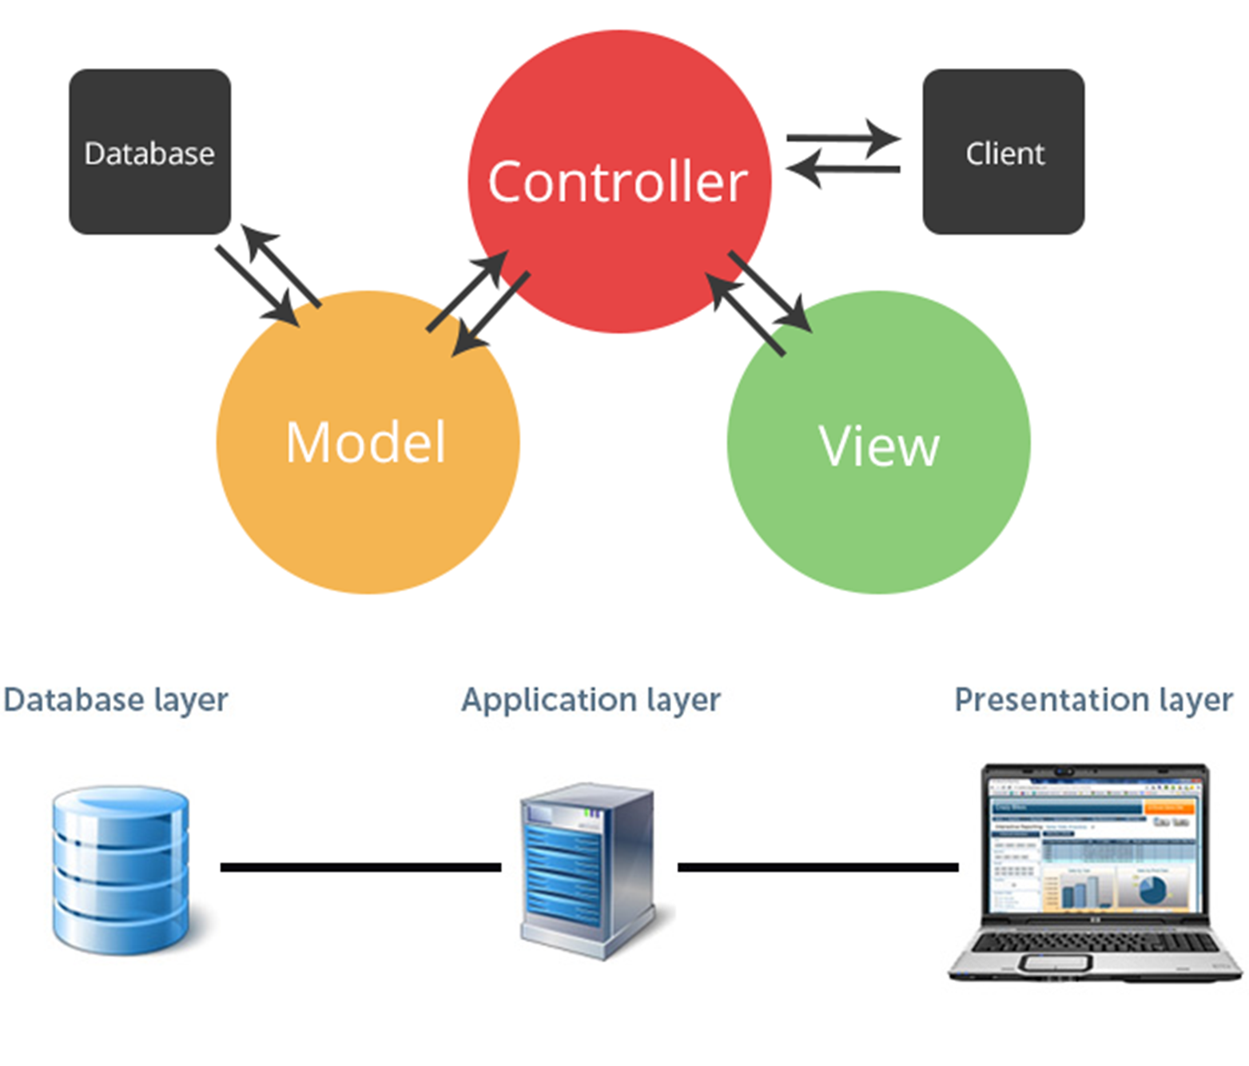
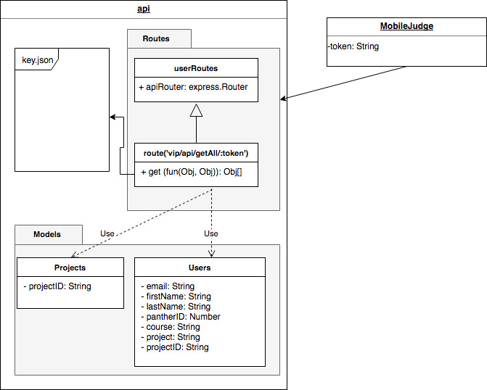
School of Computing & Information Sciences
Senior Project, 2018, Spring
Mobile Judge / VIP Website 8.0
Student: Sergio Hernandez Padron, Florida International University
Professor: Masoud Sadjadi, Florida International University
Problem
Judge registration before the event causes conflicts with student grading
Grading questions are broad and do not distinguish students from different courses.
Data consistency issues due to multiple data sources.
Solution
Implemented new login/registration flow for judges using a three token system.
Implemented course selection algorithm for the assignment of questions to judges depending on student course.
Implemented a summary and consistency check tool that analyses and displays this data in a dashboard.
Current System
Judge registration is done at the event entrance one by one.
All enabled question are asked to all students without looking into what course they are.
Data is visually analyzed in a record by record basis.
Screenshots
Fig. 1: Example summary and consistency check dashboard
Fig. 2: Example of token request screen on mobile
Fig. 3: Example multiple course selection algorithm for the assignment of questions.
Requirements
Implement a three token system to provide self-registration to judges once they arrive to the event.
Allow administrators to create questions per student course.
Detect data inconsistencies in the database that degrades the state of the system.
Ensure data is structured accordingly in VIP to be exposed and consumed by Mobile Judge.
System Design
Implementation
System is implemented using the mean stack, Sencha & MySQL:
MongoDB/MySQL - Data store
ExpressJS – API/Backend
AngularJS – Front end JavaScript framework
NodeJS – JavaScript runtime environment
Sencha – UI JavaScript library for mobile web development
Verification
Testing done locally for each User Story with a mix of Unit and Integration Tests
User Stories merged onto a develop server as they are completed so the entire system can be tested.
Object Design
Summary
Improved functionality and smoothness of Mobile Judge by adding a more flexible registration process.
Improved functionality of Mobile Judge by adding course distinction to judge’s questions about student’s presentation.
Increased data consistency of VIP Website by creating important data checking tool and dashboard.
Acknowledgement
The material presented in this poster is based upon the work supported by Dr. Masoud Sadjadi. I am very thankful for the help that I received from my development teammate, David Venta.
Notes:
1

